Slide 1
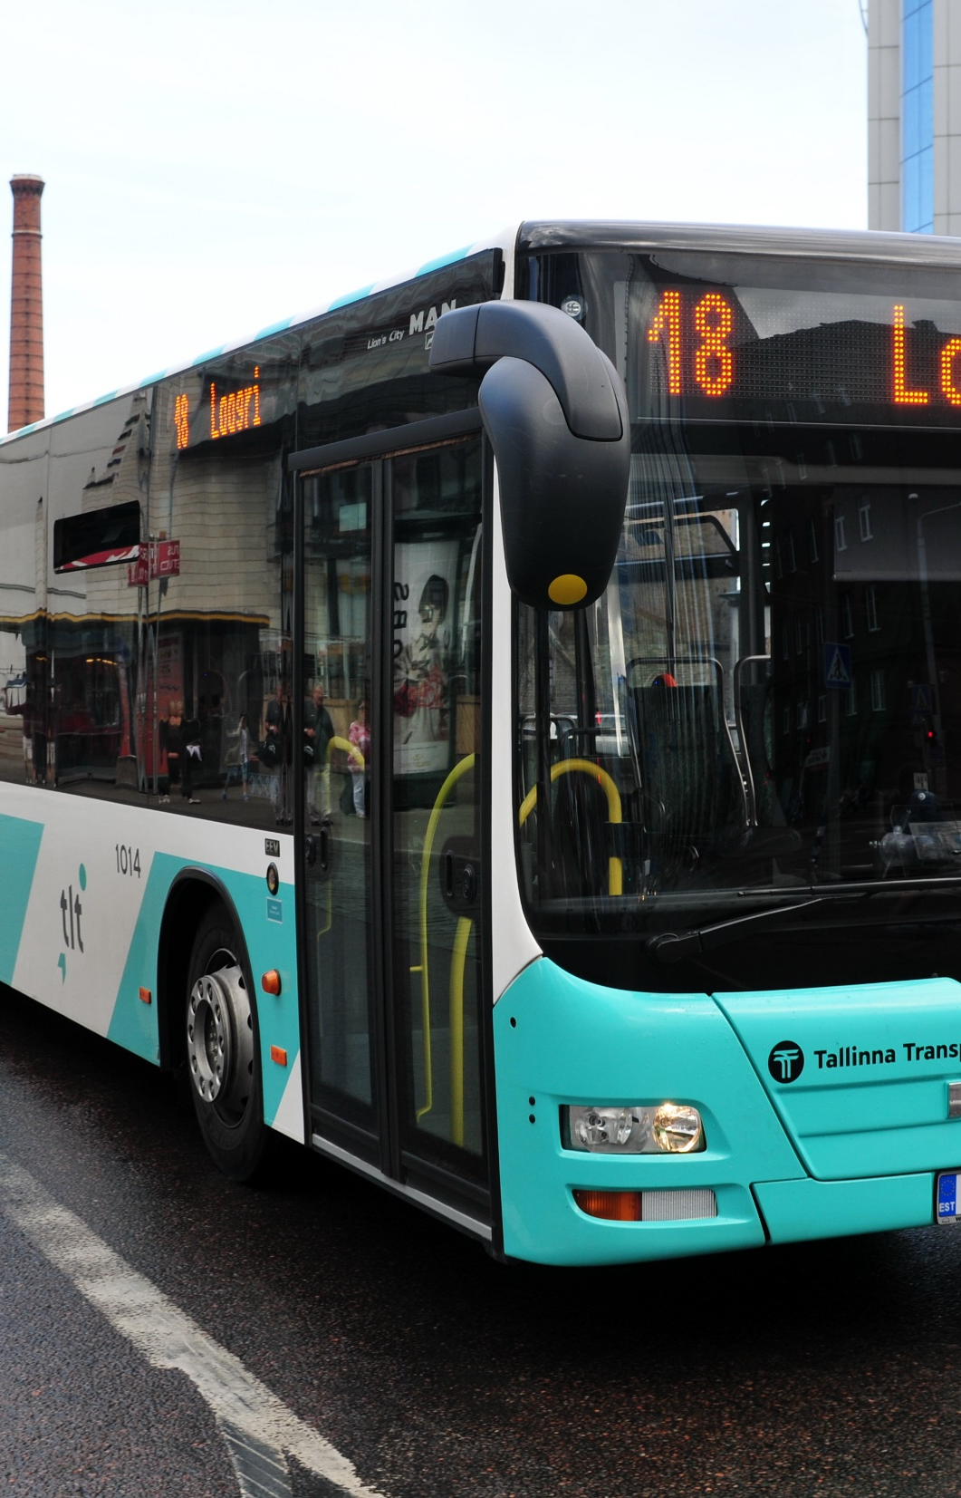
Tallinn public transport 2020
Presentation

Slide 2
Survey methodology
The sample size is 500 Tallinn residents, the results of the survey can be extended to the corresponding population of Tallinn
Conduct of the survey
Due to the corona crisis, the survey period was divided into two parts: 5-12 March and 3-14 September 2020.
The interview was conducted as face-to-face interviews through interviewers.
Statistical fluctuations are in the range of 4-5%.

Slide 3
Proportions of public transport passengers 2003-2020
Compared to the previous survey, the use of public transport has decreased. This can be attributed to the general decline in the use of public transport in corona conditions.
Notes:
Sõitis põhiliselt ühistranspordiga – Used mainly public transport
Sõitis üldse ühistranspordiga - - Occasionally used public transport (Tõlkija: Ma ei saa sellest eestikeelsest lausest tegelikult aru)

Slide 4
Average rating for public transport modes
The overall satisfaction rating of the TLT service was 4.13.
The average scores are 4.36 on the tram, 4.1 on the bus and 3.94 on the trolley.
87% of city dwellers are satisfied with the quality of tram traffic, 78% with buses and 64% with trolleys.
In the case of buses, the residents of Haabersti and Mustamäe gave higher than average ratings,
In the case of trams, equally residents of North Tallinn, Haabersti and Lasnamäe
In the case of trolleys, the residents of Mustamäe and Nõmme.
Notes:
Trammid -Trams
Bussid - Buses
Trollid – Trolleys
Väga hea – Very good
Väga halb – Very bad
Ei oska öelda -Cannot say

Slide 5

Satisfaction with the organization of public transport in Tallinn
About 95% of everyday passengers are satisfied.
The youngest group (aged 15-19) is the most satisfied - 96%.
The residents of Lasnamäe expressed the highest satisfaction - 97%.
Notes:
Hinnang 1-5 – Rating 1-5
Rahulolu – Satsifaction
Täiesti rahul – Completely statisfied
Üsna rahulolematu – Fairly unsatisfied
Üsna rahul – Fairly satisfaid
Täiesti rahulolematu – Completely satisfied
Ei rahul ega rahulolematu – Neither satisfied or unsatisfied
Ei oska öelda – Cannot say

Slide 6
Preference of means of transport
Preferences vary by district
Everyday bus users predominantly prefer the bus to the same destination, but the same does not apply to trams and trolleys, where the preference is higher among infrequent passengers.
The district references are as follows: Northern Tallinn - tram 52%, Haabersti - bus 72%, City Center - tram 69%, Kristiine - tram 48%, Lasnamäe - bus 88%, Mustamäe - bus 63% and Nõmme - bus 57%.
Notes:
Buss – Bus
Tramm – Tram
Troll – Trolley
Elektrirong – Electric train

Slide 7
Key factors in public transport
Adherence to the schedule and cleanliness of the vehicle in the foreground
Notes:
Sõiduplaanist kinnipidamine – Adherence to the schedule
Sõiduki puhtus, korrashoid – Cleanliness, condition of the vehicle
Parajad sõiduintervallid – Suitable travel intervals
Sõiduki mugavus – Convenience of the vehicle
Peatuste teatamine – Announcing stops
Sõitjate hulk liikluses – The number of passengers in the traffic
Turvalisus ühissõidukeis – Safety in means of public transport
Sõiduplaani püsivus, stabiilsus – Stability of the schedule
Sõiduki sisekliima (soojus, ventilatsioon) – Internal climate (warmth, ventilation) of the vehicle
Juhi käitumine – Behaviour of the driver
Peatuste asukohad – Locations of stops
Sihtpunkti jõudmise kiirus - Speed of arrival of destination
Info kättesaadavus (sõiduplaanid, liinid) – Availability of information (schedules, routes)
Ei oska öelda - Cannot say

Slide 8
Comparison with other countries
Tallinn's public transport is world class
Question: How does Tallinn's public transport feel in general compared to cities in other countries?
The explanations highlighted positive features 44 times and shortcomings 35 times.
It was most often praised that the transport was free, convenient, adhered to the schedule and clean.
In some cases: there are fewer people; There are fewer residents in Tallinn. It was once mentioned that "Better is only in Japan".
Notes:
Ei oska hinnata 47% – Unable to rate 47%
Parem teistes riikides 29% - Better in other countries 29%
Halvem, kui teistes riikides 7% - Worse than in other countries 7%
Samaväärne teiste riikidega 17% - Equivalent to other countries 17%

Slide 9
Possible tram lines from the city center
Notes:
Kesklinn – Lasnamäe – City center – Lasnamäe
Kesklinn - Mustamäe – City center - Mustamäe
Kesklinn – Viimsi – City center – Viimsi
Kesklinn – Õismäe – Tabasalu – City center – Õismäe – Tabasalu
Kesklinn- Põhja-Tallinn läbi Sõle tänava – City center – Northern-Tallinn via Sõle street
Kesklinn – Nõmme – Saue – City center – Nõmme – Saue
Kesklinn – Maardu – City center – Maardu
Kesklinn – Rae vald – City center – Rae parish
Muu – Ei oska öelda – Other – Cannot say

Slide 10
Support for a tram line to the port
The citizen is waiting for the port tram
78% of the respondents supported the port line.
Support has remained high in previous surveys - 72% last time and 77% in 2017.
70% of the public transport users in Tallinn are in favor of electric buses, 67% are in favor of building new tram connections and 61% of the respondents are in favor of buses using biogas.
Notes:
Pooldan 50%– Support 50%
Pigem pooldan 28% - Rather support 28%
Pigem ei poolda 5% - Rather do not support 5%
Ei poolda 2% - Do not support 2%
Ei oska öelda 15% - Cannot say 15%

Slide 11
Under what conditions would you prefer public transport to a car
The question was asked to the users of a car as the main vehicle
Notes:
Vähem ümberistumisi – Less changing from a vehicle to another
Lühemad intervallid – Sorter intervals
Peatused lähemal kodule/sihtkohale – Stops closer to home/destination
Tühjemad sõidukid – Emptier vehicles
Paremad algus- ja lõpuajad – Better beginning and end times
Sõidukis turvalisem – Safer in the vehicle
Muu – Other
Midagi sellist ei ole/ ei kavatse kasutada ühistransporti – Nothing/am not planning to use public transport
Ei oska öelda – Cannot say

